Slide 1
Multiplayer Tag Game
By Aastha Mahajan

Slide 2
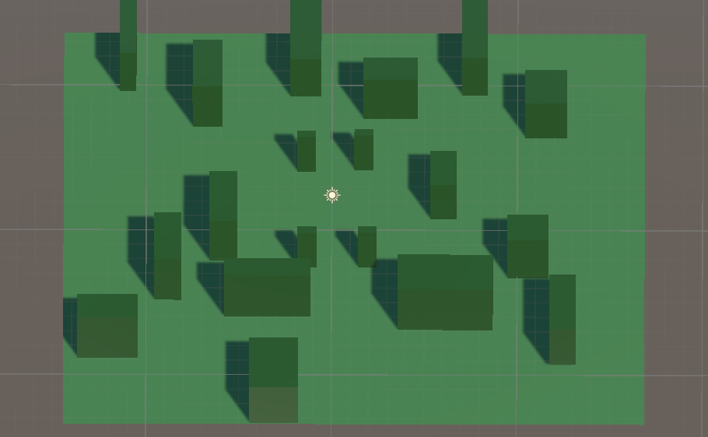
Game Objective and Rules
Objective:
Randomly chosen “It” player tags others.
“It” player’s material/color changes
Tagged player becomes “It” immediately.
Game ends when the timer runs out or all players are tagged.
Gameplay:
Players navigate an arena with open spaces and obstacles.
Real-time updates ensure smooth, synchronized gameplay.

Slide 3
Tools and Game Components
Unity Netcode for GameObjects
Synchronizes player positions and status in real-time.
Ensures smooth communication between server and clients.
Unity Physics Engine
Handles collision detection for tagging and player interactions.
Manages obstacles and adds complexity to the game environment.

Slide 4
Tools and Game Components
Parallel Processing
Splits tasks like player movement and tag detection.
Ensures simultaneous updates without server overload or lag.
Components:
PlayerCon: Handles player behavior.
GameManager: Controls game flow and assigns ‘It’ status.
ClientNetworkTransform: Enables client-side authority for smooth movement.

Slide 5
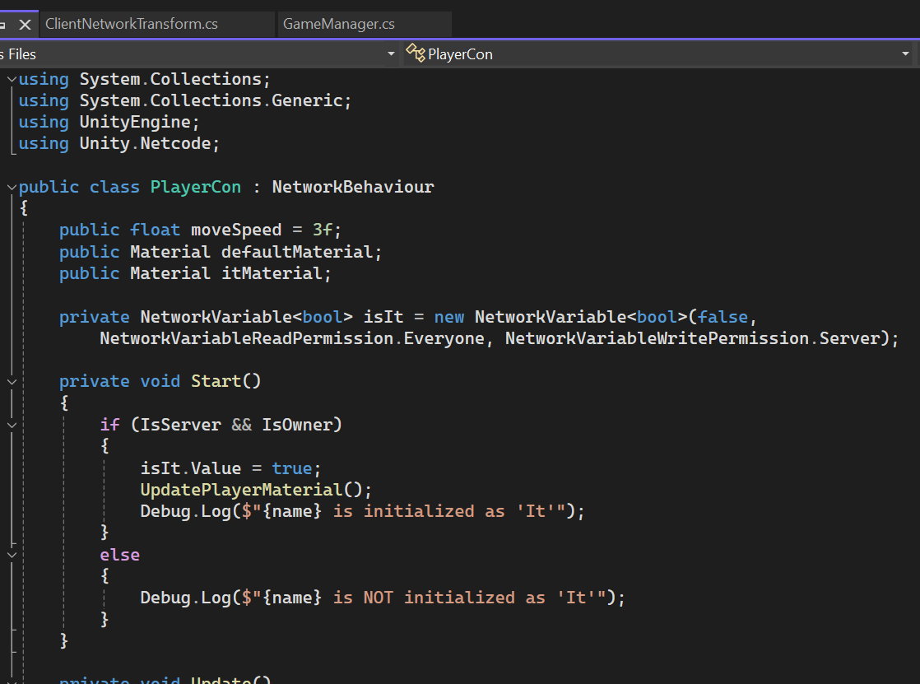
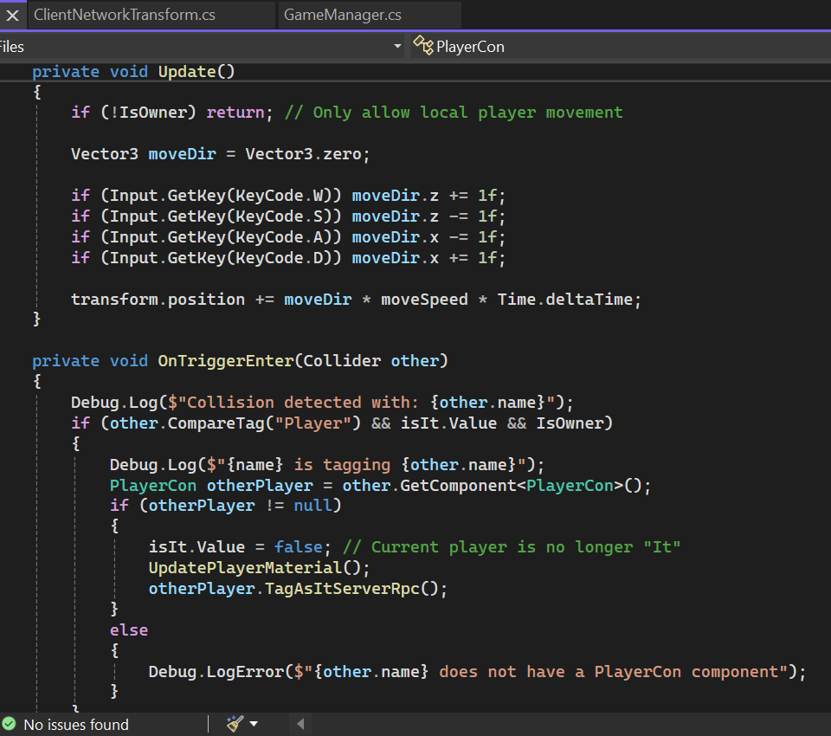
PlayerCons.cs

Slide 6
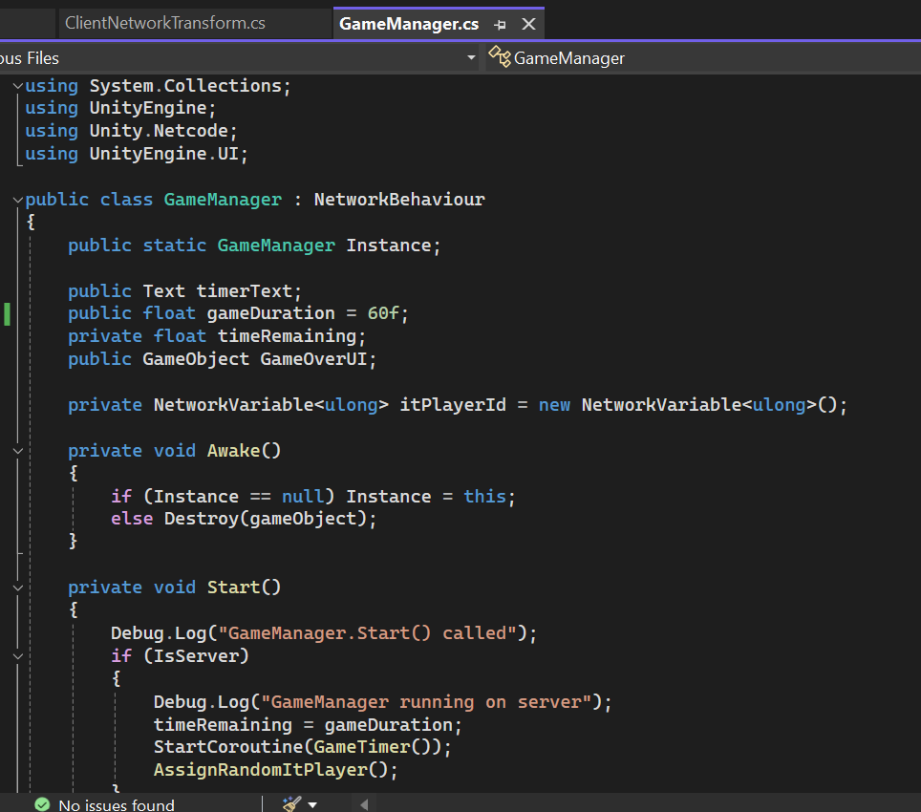
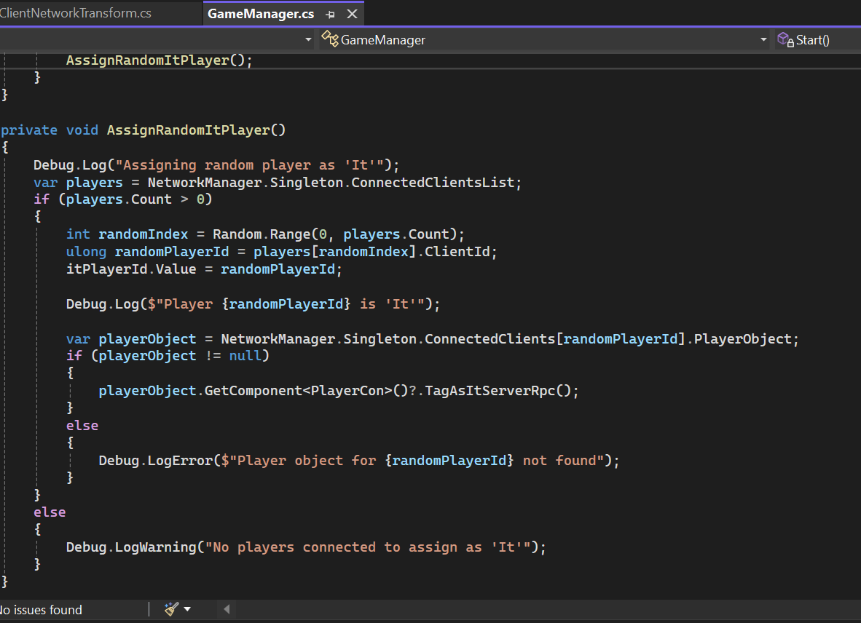
GameManager.cs

Slide 7
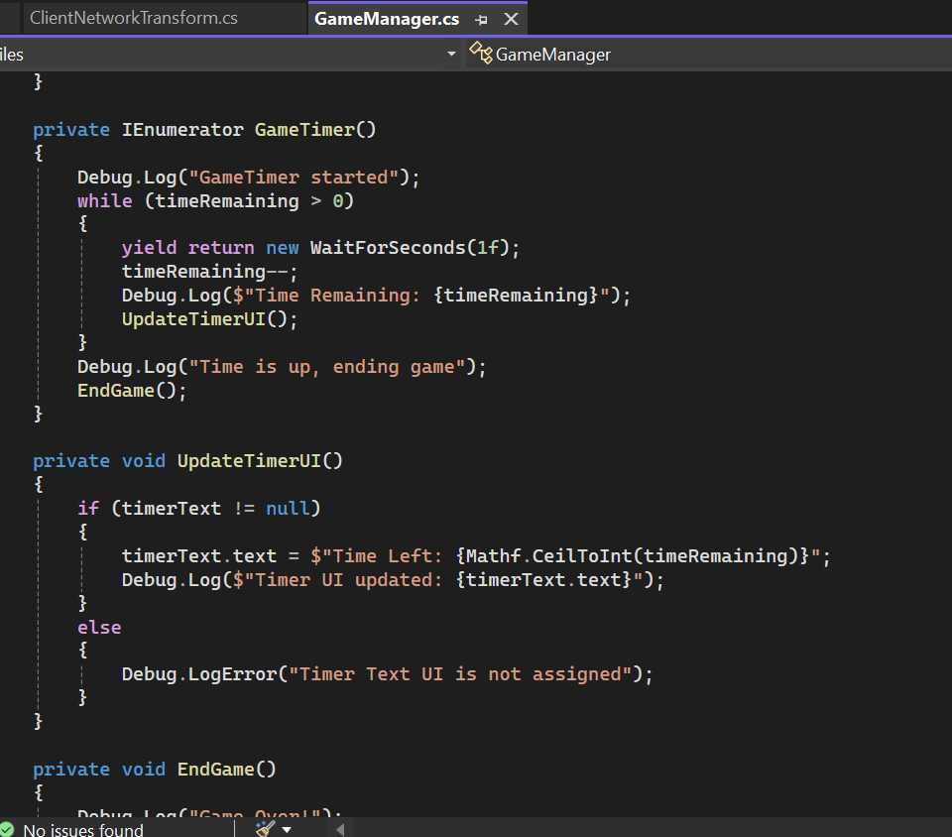
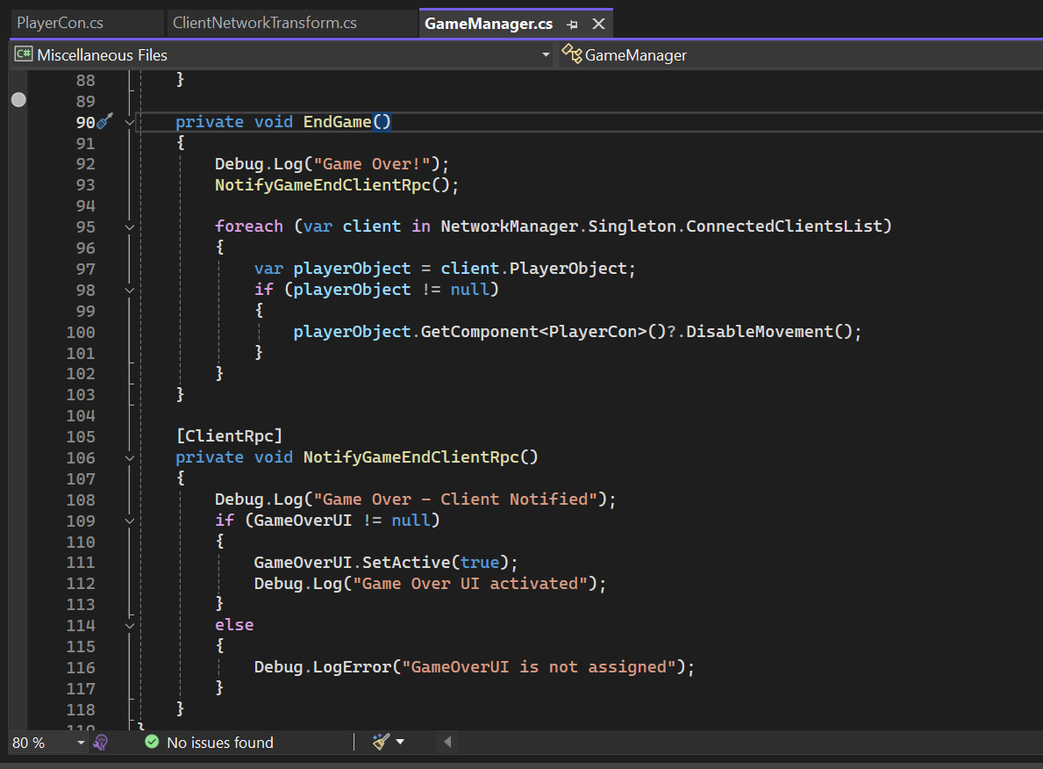
GameManager.cs

Slide 8
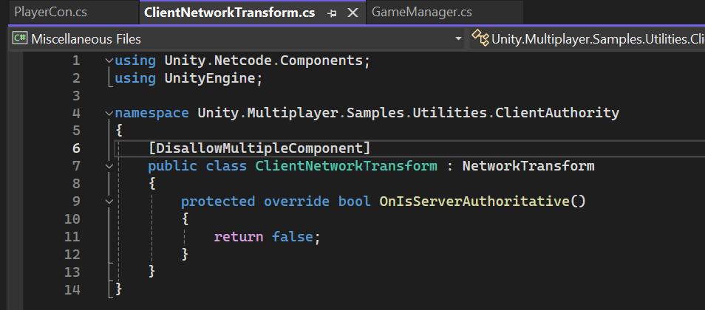
ClientNetworkTransform.cs

Slide 9
Bottlenecks
Real-time state synchronization.
Collision detection over the network.
Latency and network lag.
Debugging distributed behaviors.

Slide 10
Reference
“How to create a parallel for in Unity.” Unity Discussions, 4 July 2013, https://discussions.unity.com/t/how-to-create-a-parallel-for-in-unity/75004. Accessed 6 December 2024.
“How To Multithread Your Code With Unity's JOB SYSTEM (E01) (IJob).” YouTube, https://www.youtube.com/watch?v=kREqrc8lvwI. Accessed 6 December 2024.
Jain, Sandeep. “Election algorithm and distributed processing.” GeeksforGeeks, 8 March 2023, https://www.geeksforgeeks.org/election-algorithm-and-distributed-processing/. Accessed 6 December 2024.

Slide 11
Demonstration

